Slide 1


Title: Web Scraping and Exploratory Data Analysis of Bikes from Bikewale

Slide 2
About Me:
Manikoushik Kuragayala
Student passionate about Data Analytics, Web Scraping, and Visualization.
Exploring insights from real-world datasets and analyzing market trends.
📍 LinkedIn: www.linkedin.com/in/manikoushik-kuragayala-64aa81280
💻 GitHub: https://github.com/manikoushik99

Slide 3

Introduction:
BikeWale is one of India’s leading online platforms for comparing and reviewing motorcycles.
It provides details such as brand, model, price, engine capacity, mileage, power, and ratings.
This project aims to scrape data from BikeWale’s website, clean and analyze it to uncover:
Brand-wise pricing patterns
Relationship between engine capacity, power, and mileage
Market trends in different bike segments

Slide 4

Business Problem:
Bike data on BikeWale is unstructured and difficult to compare manually.
Lack of centralized insights for pricing, performance, and mileage analysis.
Difficult to identify brand-wise market segments and positioning.
Consumers face challenges balancing performance and affordability.
No clear visibility into brand dominance across categories.
Absence of competitive benchmarking for data-driven strategies.
Limited analytical insights hinder marketing and pricing decisions.

Slide 5
Objectives:
To extract and structure bike data from the BikeWale website using web scraping.
To clean and preprocess the dataset for accurate analysis.
To visualize brand-wise and segment-wise market trends.
To analyze relationships between price, mileage, and engine capacity.
To identify top-performing brands in different bike categories.
To derive actionable insights for manufacturers and consumers.
To demonstrate the complete data pipeline — scraping, cleaning, and EDA.

Slide 6
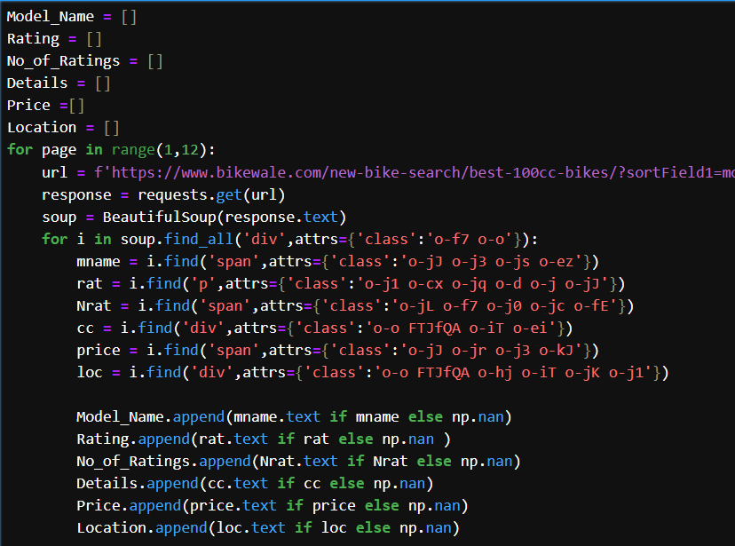
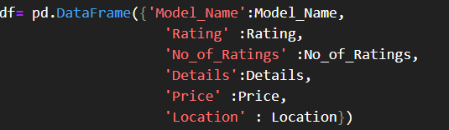
Web Scraping:
Scrapes multiple pages (1–11) of BikeWale’s new bike listings.
Extracts data fields: Model Name, Rating, Number of Ratings, Engine Details, Price, and Location.
Uses BeautifulSoup to parse HTML content and identify elements by their CSS classes.
Handles missing values using np.nan to maintain data consistency.
Stores all values into separate lists for each attribute.
Combines them later into a structured DataFrame for cleaning and EDA.

Slide 7






Tools Used:

Slide 8

Data Cleaning Steps:
Removed unwanted characters and symbols (₹, cc, kmpl) from text columns.
Converted Price, Rating, and No. of Ratings columns to numeric values.
Split combined details (like engine, mileage, type) into separate columns.
Replaced missing values (NaN) with appropriate defaults or averages.
Standardized inconsistent brand and model names for uniformity.
Removed duplicate entries and extra spaces from text fields.
Verified data types and ensured correct formatting for analysis.

Slide 9
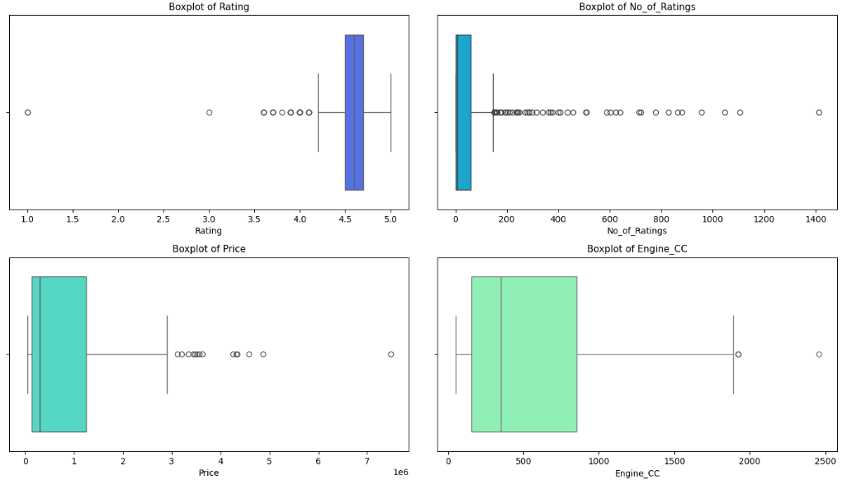
Data Visualization:
Univariate Numerical Analysis:
The boxplots show that most variables like Rating, Price, and Engine_CC have right-skewed distributions with several high-value outliers.
Ratings are concentrated around 4.5, while Price and Engine_CC exhibit large variation, indicating diverse bike segments from budget to premium.

Slide 10
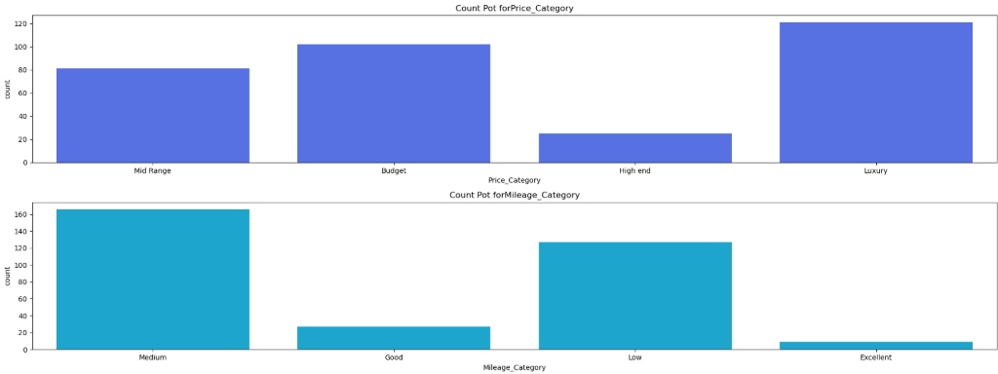
Univariate Categorical Analysis
Most bikes fall under Luxury and Budget price categories, showing dominance of extreme segments.
In mileage distribution, Medium and Low mileage bikes are more common, indicating a market focus on balanced performance.

Slide 11
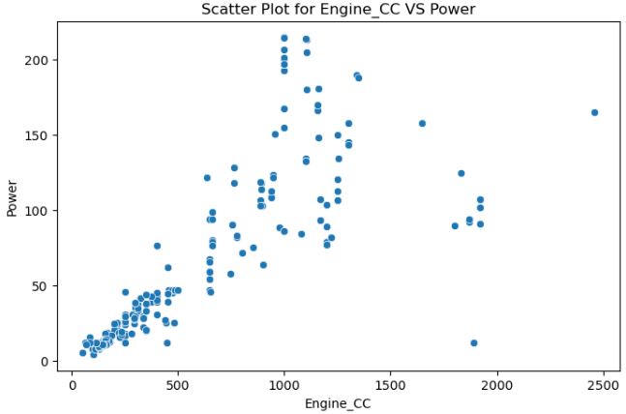
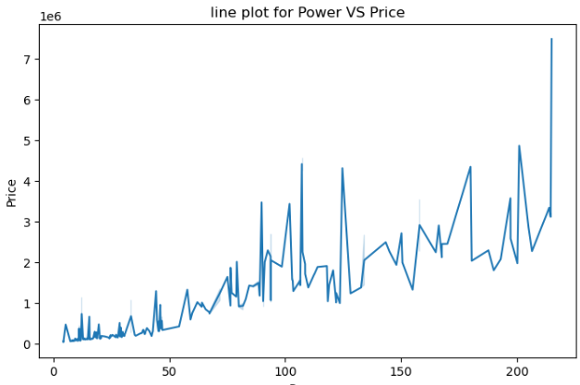
Bivariate Analysis
Numerical vs numerical
The scatter plot shows a strong positive correlation between engine capacity and power.
As Engine_CC increases, the Power output rises significantly, indicating performance scaling with engine size.
The line plot shows a positive trend indicating that bikes with higher power generally have higher prices.
Some fluctuations suggest that factors like brand and features also influence pricing beyond engine performance.

Slide 12
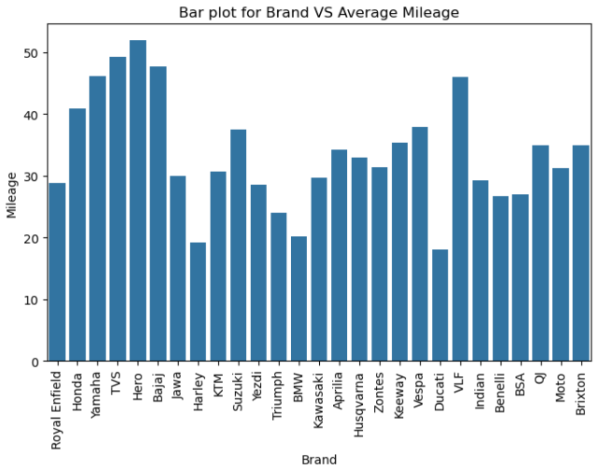
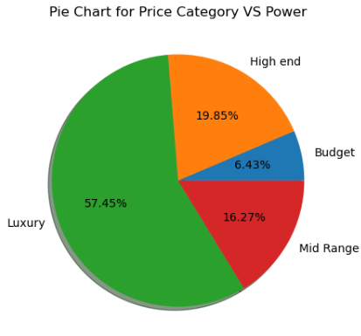
Numerical VS Categorical:
The bar plot shows that Hero, TVS, and Honda deliver the highest average mileage, dominating the commuter segment.
Premium brands like KTM, Harley, and BMW have lower mileage, reflecting a focus on performance over efficiency.
The pie chart shows that Luxury bikes contribute the highest share of total power (≈57%).
Budget and Mid-range segments have much lower power output, emphasizing their focus on fuel efficiency over performance.

Slide 13
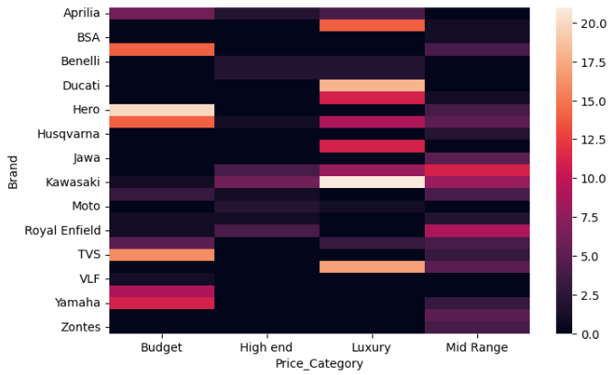
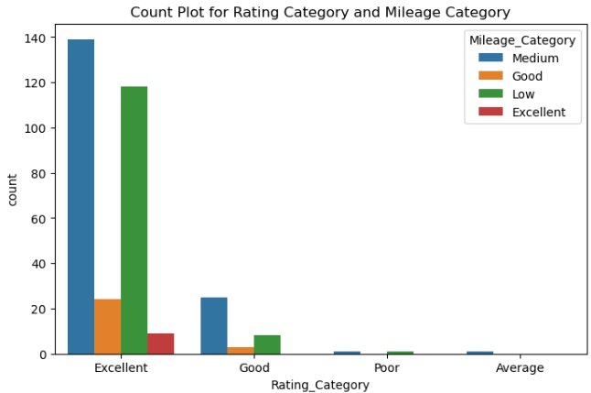
Categorical VS Categorical:
The heatmap shows that brands like Hero, Yamaha, and TVS dominate the Budget and Mid-range categories.
Premium brands such as Ducati, Kawasaki, and Royal Enfield are concentrated in the Luxury segment, highlighting clear market segmentation.
Bikes with Excellent ratings mostly fall under Medium and Low mileage categories.
This suggests that higher-rated bikes prioritize performance and quality over extreme fuel efficiency.

Slide 14
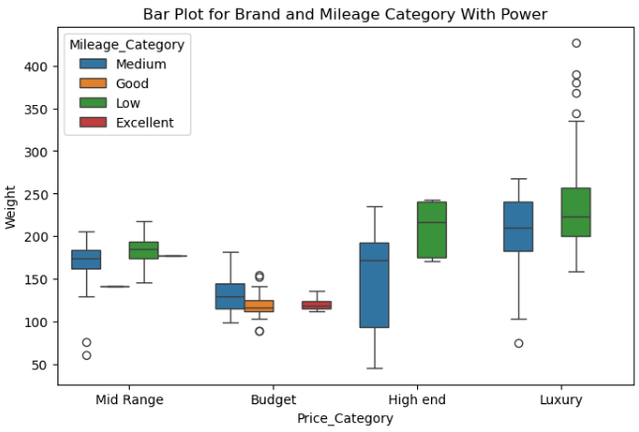
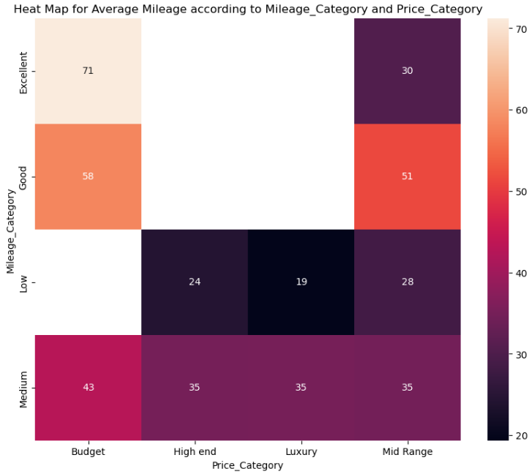
Multivariate Analysis:
Luxury and High-end bikes exhibit higher power and weight, with Low to Medium mileage levels.
Budget and Mid-range categories show lower power but better mileage consistency, reflecting efficiency-focused design.
The heatmap shows that Budget bikes have the highest average mileage (71 kmpl), while Luxury and High-end bikes show lower mileage values.
This highlights a clear inverse relationship between price and fuel efficiency across categories.

Slide 15
Key Business Questions
Which brands offer the most bike models in the Indian market?
What is the relationship between engine capacity, power, and price?
Which price segment (Budget, Mid-range, High-end, Luxury) dominates the market?
How does mileage vary across different brands and price categories?
Which brands or segments provide the best mileage-to-price ratio?
How do ratings correlate with mileage and price levels?

Slide 16
Conclusion:
Engine capacity and power show a strong positive correlation — higher CC bikes deliver greater performance.
Luxury and high-end bikes dominate power output but have lower mileage, focusing on performance over efficiency.
Budget and mid-range segments provide the best mileage and affordability, appealing to most consumers.
Hero, Honda, and TVS lead in fuel-efficient bikes, while Royal Enfield and KTM dominate premium categories.
Price and mileage exhibit an inverse relationship — as price increases, mileage tends to decrease.
Overall, the Indian bike market reflects a clear divide between commuter-focused and performance-driven brands.

Slide 17
Experience– Web Scraping & Data Analysis:
Scraped BikeWale data using Python libraries — BeautifulSoup and Requests.
Extracted structured details such as Model Name, Brand, Price, Mileage, and Ratings.
Cleaned and standardized data using pandas for accurate analysis.
Performed EDA to uncover trends in pricing, mileage, and performance across brands.
Created visualizations (boxplots, scatterplots, heatmaps) for insight communication.
Learned end-to-end workflow — Scraping → Cleaning → Analysis → Visualization → Insights.

Slide 18
Challenges – Web Scraping & Data Analysis:
Inconsistent HTML structures across BikeWale pages caused parsing difficulties.
Encountered missing or hidden fields like price and mileage for some models.
Had to manage duplicate entries and inconsistent brand naming.
Cleaning numeric data was tricky due to symbols and mixed text formats (₹, cc, kmpl).
Faced anti-scraping restrictions limiting multiple page requests.
Selecting the most meaningful visualizations to convey insights effectively was challenging.

Slide 19


